Slide 1
B.TECH CSE with Specialization in DevOps
Advanced Linux
Role of Administrator
Notes:
Notes to the Facilitator:
Introduce the module to the participants and tell them that you will be talking about Linux, the different types Linux distributions, role of Linux administrator, difference between developer and administrator, critical tasks in Linux and Linux installation scenarios.
Notes to the Participants:
You will be discussing about Linux, the different types Linux distributions, role of Linux administrator, difference between developer and administrator, critical tasks in Linux and Linux installation scenarios.

Slide 2
Module Objectives
At the end of this module, you will be able to:
List different types of Linux flavors
Explain the role of Linux administrator
Discuss the difference between developer and administrator
Define the critical tasks in Linux
Describe Linux installation
Notes:
Notes to the Facilitator:
Explain the module objectives to the participants.
Notes to the Participants:
You will be informed about the module objectives.
At the end of this module, you will be able to:
List different types of Linux flavors
Explain the role of Linux administrator
Discuss the difference between developer and administrator
Define the critical tasks in Linux
Describe Linux installation

Slide 3
Module Topics
Let us take a quick look at the topics that we will cover in this module:
What is Linux and Different Types of Linux
Run Levels in Linux
Role of Linux Administrator
Developer vs Administrator
Critical Tasks in Linux
Installing Linux
Notes:
Notes to the Facilitator:
Inform the participants about the topics that they will be learning in this module.
Notes to the Participants:
You will learn about the following topics in this module:
What is Linux and Different Types of Linux
Run Levels in Linux
Role of Linux Administrator
Developer vs Administrator
Critical Tasks in Linux
Installing Linux

Slide 4
1.1 Introduction to Linux
Following are the key details of Linux:
Linux is a free and open source operating system built on Linux Kernel.
Linux is packaged as a Linux distribution for both server and desktop use.
Linux is the most used operating system.
Linux is open source, but the trademark on the name Linux is with its creator Linus Torvalds. It is licensed under GPLv2.
Notes:
Notes to the Facilitator:
Give an introduction about Linux to the participants.
Notes to the Participants:
Linux is a free and open source OS built of Linux Kernel. It is packaged as a Linux distro for both server and desktop use.
Linux License: The source code of Linux is under copyright by many individual authors, and licensed under the GPLv2 license.

Slide 5
1.2 Different Types of Linux
There are many Linux distributions available. Most used distributions are listed below:
Ubuntu
It was announced in 2004 and it is an open source OS. Ubuntu has a predictable 6 months release. The latest version of Ubuntu is 18.04
Debian
Debian is known as one of the most well tested and bug-free OS available today. It used all open source components
Fedora
Fedora is a free version of Red Hat Linux. It has a 6 month release cycle.
Notes:
Notes to the Facilitator:
Discuss about different types of Linux platforms.
Notes to the Participants:
Linux has a number of different versions to suit any type of requirement. These types of different versions are called distributions. Most of the distribution of Linux can be downloaded for free. Red Hat Enterprise Linux (known as RHEL) is a commercial version and it requires a subscription to download OS or other softwares.

Slide 6
1.2 Different Types of Linux (Contd.)
Red Hat
Commercial version of Red Hat since 2003.
CentOS
It’s an open source and community supported computing platform. It is compatible with upstream source, Redhat Linux.
OpenSUSE
Formerly SUSE Linux is a Linux distribution sponsored by SUSE Linux Gmbh.
Notes:
Notes to the Facilitator:
Discuss about different types of Linux platforms.
Notes to the Participants:
Red Hat Linux:
The three types of Linux support provided by Red Hat are as follows:
Hardware Support
Software Support
Hands-on Support
Ubuntu, CentOS, Fedora, OpenSUSE, etc., are free. By default, these Linux distributions do not come with a GUI. You can install a GUI package on top of the OS. To work without GUI you need a solid understanding of the Linux command line.

Slide 7
1.3 What is GPLv2?
Following are the key details of GPLv2:
GPLv2(GNU Public license) has emerged from the GNU project.
It explicitly states that the software being released is free.
It is acceptable to take the software and resell it even for a profit. In resale, seller has to release full source code, including all the changes.
Violating the GPLv2 license would mean losing the right to distribute the GPLv2 code in the future.
GPLv2 is compatible with Linux, and a commercial license for other operating systems.
Notes:
Notes to the Facilitator:
Discuss about GPLv2.
Notes to the Participants:
The GNU General Public License (GNU GPL or GPL) is a widely used free software license, which guarantees end users the freedom to run, study, share and modify the software. The license was originally written by Richard Stallman of the Free Software Foundation (FSF) for the GNU Project, and grants the recipients of a computer program the rights of the Free Software Definition.
The Linux Kernel is provided under the terms of the GNU General Public License version 2 only (GPL-2.0), as provided in LICENSES/preferred/GPL-2.0, with an explicit syscall exception described in LICENSES/exceptions/Linux-syscall-note.
Red Hat, Facebook, Google, and IBM commit to providing a fair cure period to correct open-source GPLv2 software license compliance issues.

Slide 8
1.4 Run Levels in Linux
Seven run levels are supported by the Linux kernel, which are as follows:
0
Shutdown the system
1, S, s
Single user mode, used for maintenance
2
Multi user mode with graphical interface (Ubuntu/Debian)
3
Multi-user text mode (Red Hat/CentOS), that starts the system normally
4
Undefined
5
Multi-user mode with graphical interface (Red Hat/CentOS)
6
Reboots the system
Notes:
Notes to the Facilitator:
Explain the different run levels in Linux.
Notes to the Participants:
Run level specifies the modes in which the Unix OS runs. According to the run level, some of the services will be in stopped or started state. This helps the user have control over the behavior of the machine and system administrators use them to define the subsystems that are working. Run levels are expressed as numbers. Once the Linux kernel boots, the init program will read the /etc/inittab in order to determine the behavior for each run level.
Different run levels in Linux are given in the slide above. Many of the Linux servers lack a GUI and they will start in run level 3. Servers that have a GUI and the desktop Unix systems start run level 5.
Init scripts
Init program in Unix and other Unix-like systems initializes all the other processes. The default run level of the system is set using the /etc/inittab file. It is this runlevel that the system will start up during reboot. The folder /etc/rc.d houses the applications that are started by init.
chkconfig
The chkconfig tool is used by CentOS for controlling the services that are started at runlevels. The command chkconfig –list is used to display the list of services that are enabled or disabled for each runlevel.

Slide 9
What did You Grasp?
Which version of Linux is commercial version?
CentOS
Ubuntu
Debian
RHEL
Linux is licensed under _______?
Apache
GPLv2
Open source
None of the above
Notes:
Notes to the Facilitator:
Tell the participants that they will be going through a knowledge check question.
Answer:
1. d. RHEL
2. b. GPLv2

Slide 10
What did You Grasp?
Which run level of Linux is used to reboot?
0
1
3
6
Linux run level 4 is _________?
Multi user mode
Multi text mode
Undefined
Reboot
Notes:
Notes to the Facilitator:
Tell the participants that they will be going through a knowledge check question.
Answer:
3. d. 6
4. c. Undefined

Slide 11
2.1 Role of Linux Administrator
Linux administrator has the following roles:
Install required software tools
Apply OS patches, software upgrades including antivirus upgrades and security patches, etc.
Monitor the server – CPU, Memory, Disk usage, etc.
Install and manage application like – DNS, Apache, MySQL, PHP, etc.
Responsible for frequent data backup
Senior linux administrator should train other administrators
Reviewing all the error logs and fixing the issues
Notes:
Notes to the Facilitator:
Explain the various roles of Linux administrators.
Notes to the Participants:
System administration has become critical for an organization that requires a strong IT infrastructure. Hence, the need for efficient Linux administrators is the need of the hour. The job profile might change from each organization as there may be added responsibilities to the role.
Typically day to day responsibilities of a Linux administrator include:
Commissioning and decommissioning of resources as per the need
Disk management
User and access management
Build and release management
Troubleshooting application issues
Scanning through endless lines of the log
Having project meetings
Keep an eye on server and application health
Keeping in check the various components of your infrastructure ensuring the maximum uptime

Slide 12









2.1 Role of Linux Administrator (Contd.)
Monitoring the servers is one of the important tasks
Troubleshoot the issues related to applications hosted on the system
Notes:
Notes to the Facilitator:
Explain the roles of Linux administrators.
Notes to the Participants:
The important tasks of Linux administrator are to maintain:
Uptime of the system: Linux admin is responsible to monitor uptime of the system. It's very important for server administrators when the server running with mission-critical applications such as an online shopping portal, net banking portal, etc.
Stability of the system: Linux admin is responsible to maintain the stability of the system. They need to make sure the servers do not face performance issues.
On call to handle critical issues: Most of the admins need to provide on call support to handle system issues. For critical server issues on call support is provided outside working hours.

Slide 13
2.2 Developer vs Administrator
Developer
Coding and programming (C, C++, Java …)
Develops applications
Software debugging
Software testing
Architecture and design
Notes:
Notes to the Facilitator:
Explain the roles and responsibilities of a developer.
Notes to the Participants:
Becoming a software developer, also known as a computer programmer, you'll be playing a key role in the design, installation, testing and maintenance of software systems. The programs you create are likely to help businesses be more efficient and provide a better service. Based on your company’s particular requirements, you might be responsible for writing and coding individual programs or providing an entirely new software resource. The specifications you’ll work on will often come from IT analysts. Software developers are employed across virtually all industry sectors, from finance and retail to engineering, transport and public organizations, so the projects you work on can be highly varied.

Slide 14
2.2 Developer vs Administrator (Contd.)
Administrator
System administration (Desktop/Server)
Apply OS Patches
Monitoring performance of servers
Install required softwares
Create backup and recovery policy
User management
Notes:
Notes to the Facilitator:
Explain the role of administrator.
Notes to the Participants:
The Linux system administrators are responsible for installing, configuring and maintaining the Linux servers and workstations. They are responsible for maintaining the network environment as well as the health of the network and servers. Their day to day responsibilities include:
Linux administrator is responsible to apply operating system patches, updates and configuration changes.
Linux administrator is responsible to install and configure new hardware and software.
Linux administrator is responsible for adding, removing and updating user account information, resetting password.
Linux administrator is responsible to monitor the server and for performance tuning.

Slide 15
2.3 Critical Tasks of Linux Administrator
System administrator (Desktop/Server)
Critical Tasks of Linux Administrator
Apply OS Patches
Monitoring performance of servers
Install required software
Create backup and recovery policy
Managing software deployments
Notes:
Notes to the Facilitator:
Explain critical tasks of Linux administrator.
Notes to the Participants:
Linux system administrators are required to do the following tasks:
Create and update repositories. At the same time they must be able to install packages, remove or search them.
Setting permissions on files and directories. They need to be good at special permissions such as SGID, SUID and sticky bits.
Process management. This is something practically required in a company environment. Process management commands such as top, ps, vmstat, etc., will be used by Linux admin.
Managing and creating partitions.
Sharing of files through NFS and SAMBA.
Cron job scheduling basics.
Creating Shell scripts to perform system administration.

Slide 16
2.4 Requirements for Installing Linux
A DVD drive
A network card
A CPU capable of handling 64-bit instructions
1GB of RAM (2GB is recommended)
20GB of available hard disk space
Notes:
Notes to the Facilitator:
Explain the requirements to install Linux.
Notes to the Participants:
Linux supports a wide range of PC hardware; but not even Linux supports every known device and system. Your PC must meet certain minimum requirements in order to run Linux. Linux can be installed on the system which meets above minimum requirements. If these requirements are not met there might be performance issues after installing the Linux.
Linux does not support the Intel 286 and earlier processors. However, it fully supports the Intel 80386, 80486, Pentium, Pentium Pro, Pentium II, and Pentium III processors. Nevertheless, some users feel that their 80386 Linux systems respond sluggishly, particularly when running X. So, if you want optimum performance, you should install Linux on a PC having an 80486 processor or better.
Linux also supports non-Intel processors such as the Cyrix 6x86 and the AMD K5 and K6. Most Linux users have systems that use Intel chips; if your system uses a non-Intel chip, you may find it more difficult to resolve possible problems.

Slide 17
2.5 Installing Linux
Using USB stick
Using CD-ROM
Using Virtual machine – Oracle Virtual box/VMware workstation
Notes:
Notes to the Facilitator:
Explain different methods of installing Linux.
Notes to the Participants:
Linux can be installed using USB stick, CD-ROM and Virtual machine. We will use the Ubuntu image to install as it is easy for a beginner to understand.
Installing Linux using a USB stick
This is one of the easiest methods of installing Ubuntu or any distribution on your computer. Follow the steps as per the instructions.
Installing Linux using CD-ROM
Those who like the way a CD runs should try using this method.
Installing Linux using Virtual Machine
This is a popular method to install a Linux operating system. The virtual installation offers you the freedom of running Linux on an existing OS already installed on your computer. This means if you have Windows running, then you can just run Linux with a click of a button. Virtual machine software like Oracle VM can install Ubuntu in easy steps.

Slide 18
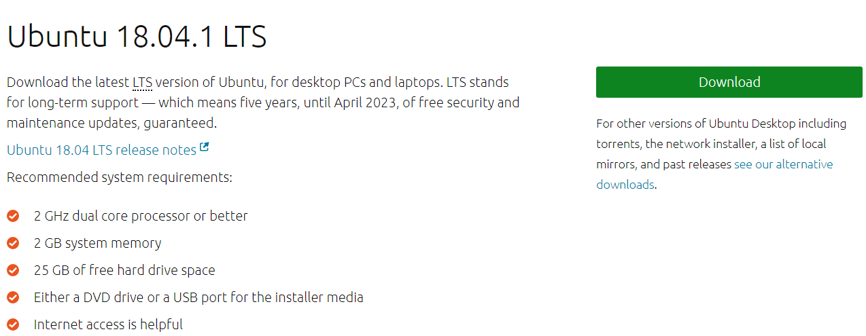
2.6 Download ISO Image
Step 1: Download the ISO image from Ubuntu website
Download Link - https://www.ubuntu.com/download/desktop
Notes:
Notes to the Facilitator:
Discuss about the steps involved in installing Linux.
Notes to the Participants:
The first step is to download the ISO image from the Ubuntu website - https://www.ubuntu.com/download/desktop.

Slide 19
2.6.1 Convert ISO Image to Bootable Disk
Step 2: Convert the ISO image to bootable disk using Poweriso software.
Download poweriso- https://www.ubuntu.com/download/desktop
Notes:
Notes to the Facilitator:
Discuss about the steps involved in installing Linux.
Notes to the Participants:
The second step is to convert the ISO image to a bootable disk using the Poweriso software.

Slide 20
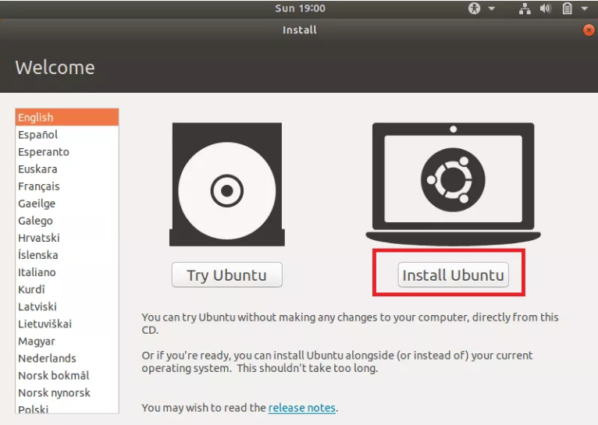
2.6.2 Boot the Virtual Machine Using ISO Image
The screenshot shows the initial screen for installing Ubuntu.
Notes:
Notes to the Facilitator:
Explain how to install Ubuntu Linux.
Notes to the Participants:
The installation process begins with clicking the Install Ubuntu option. The Try Ubuntu option can also be used, that will not make any changes to the computer. We’ll now proceed with Install Ubuntu option.
You will see the preparation screen for installing Ubuntu, click Continue and proceed.
You will then be presented with the option of selecting the installation type. You can select Erase disk and install Ubuntu, which will install Ubuntu into the virtual hard drive.
Set up the time zone and click continue. Select the keyboard layout, English(US) is selected by default.
In the next screen, provide the username and password for the Ubuntu main account. Provide the required details and click Continue.
The installation process may take up to 30 min.
The Ubuntu desktop is shown once the installation is complete.

Slide 21
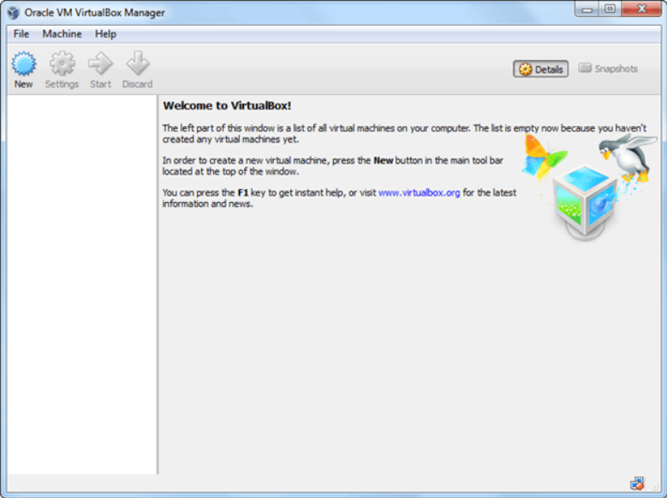
2.7 Install Linux Using Oracle Virtualbox
The screenshot shows the process, creating a new Linux machine using Virtualbox.
Notes:
Notes to the Facilitator:
Explain the participants about Linux installation using Oracle Virtualbox.
Notes to the Participants:
Create a Machine in Virtualbox
Step-1: Open Virtual box and click on the new button.
Step-2: In the next window, give the name of your OS which you are installing in virtualbox. And select OS as Linux and version as Ubuntu 32 bit. And click on next.
Step-3: Now Allocate Ram Size to your Virtual OS. We recommended keeping 1024mb (1 GB) ram to run Ubuntu better. And click on next.
Step-4: Now To run the OS in virtualbox, you have to create a virtual hard disk, click on create a virtual hard drive now and click on create button. The virtual hard disk is where the OS installation files and data/applications you create/install in this Ubuntu machine will reside
Step-5: Select VHD (virtual hard disk) option and click on next.
Step-6: Click on dynamic allocated and click on next. This means that the size of the disk will increase dynamically as per requirement.
Step-7: Allocate memory to your virtual hard drive, 8GB recommended. Click on create button.
Step-8: Now you can see the machine name in the left panel.
Step-9: Now follow the steps to install the OS.

Slide 22
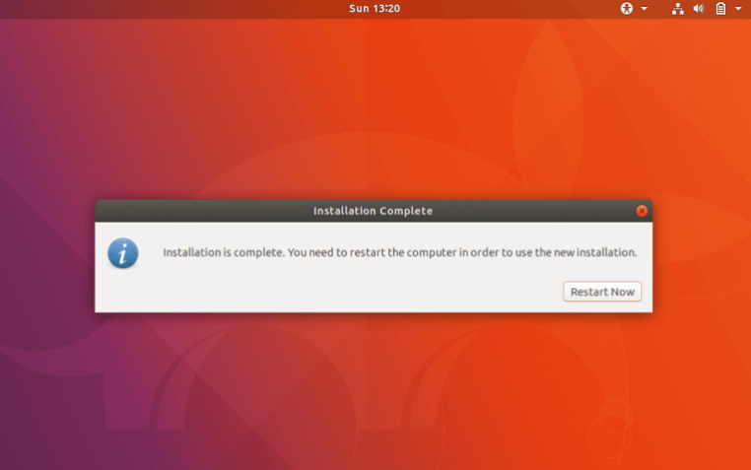
2.8. Installation Completed
The screenshot shows the completion of Linux installation.
Notes:
Notes to the Facilitator:
Explain the final step in Linux installation.
Notes to the Participants:
Once the installation is complete, restart the computer and remove the disc.
After logging back, you need to update Ubuntu.
To do this, open the terminal by pressing Ctrl+Alt+T and run the commands as follows:
sudo apt update && sudo apt dist-upgrade && sudo apt autoremove
Restart again to continue using Ubuntu.

Slide 23

Group Discussion
Notes:
Notes to facilitator:
Form different groups of students. Each group should talk different types of Linux, license types, run levels and installing Linux.
Notes to participants:
We’ve so far seen about the important concepts associated with different types of Linux, license types, run levels and installing Linux. Form different groups and each group should talk about one concept in detail along with analogies or examples to show your understanding.

Slide 24
What did You Grasp?
Which is the minimum RAM required to install Ubuntu?
1GB
2GB
3GB
4GB
Coding and programming is the responsibility of a ______?
System administrator
Developer
System analyst
Project manager
Notes:
Notes to the Facilitator:
Tell the participants that they will be going through a knowledge check question.
Answer:
1. b. 2 GB
2. b. Developer

Slide 25
What did You Grasp?
Fill in the blank. Monitoring the OS is the responsibility of a _____.
System administrator
Developer
System analyst
Project manager
Which is the easiest method of installing Linux?
Through Virtualbox
Through a NAS share
USB Drive
CD-ROM
Notes:
Notes to the Facilitator:
Tell the participants that they will be going through a knowledge check question.
Answer:
3. a. System administrator
4. c. USB Drive

Slide 26
In a nutshell, we learnt:
Linux is a free and open source operating system built on Linux Kernel.
There are many Linux distributions available. Most used distributions are Debian, Ubuntu, CentOS, Fedora, etc.
GPLv2(GNU Public license) has emerged from GNU project.
A run level is a state of init and the whole system that defines what system services are operating.
Role of Linux administrator include monitoring the server – CPU, Memory, Disk usage etc, install and manage application like – DNS, Apache, MySQL, PHP, etc.
Software developer will play a key role in the design, installation, testing and maintenance of software systems.
Linux can be installed using a USB drive, CD-ROM and Virtualbox.
Notes:
Notes to the Facilitator:
Share the module summary with the audience.
Ask the participants if they have any questions. They can ask their queries by raising their hands.
Notes to the Participants:
Now, you have reached the end of the module, In this module, you have learned:
Linux is a free and open source operating system built on Linux Kernel.
There are many Linux distributions available. Most used distributions are Debian, Ubuntu, CentOS, Fedora, etc.
GPLv2(GNU Public license) has emerged from GNU project.
A run level is a state of init and the whole system that defines what system services are operating.
Role of Linux administrator include monitoring the server – CPU, Memory, Disk usage etc, install and manage application like – DNS, Apache, MySQL, PHP, etc.
Software developer will play a key role in the design, installation, testing and maintenance of software systems.
Linux can be installed using a USB drive, CD-ROM and Virtualbox.

Slide 27
Next Module 2: xxx

